Slide 1
Software Design Evaluation
Lecturer: Ngo Huy Bien
Software Engineering Department
Faculty of Information Technology
VNUHCM - University of Science
Ho Chi Minh City, Vietnam
nhbien@fit.hcmus.edu.vn

Slide 2

Objectives
To evaluate a design using cohesion and coupling metric.

Slide 3

Contents
Systems and Modules Representation
Size
Length
Complexity
Cohesion
Coupling

Slide 4

References
Lionel Briand et al. (1996). Property-Based Software Engineering Measurement.
Shyam R. Chidamber and Chris F. Kemerer (1994). A Metrics Suite for Object Oriented Design.

Slide 5

Metric Based Evaluation

Slide 6
Systems and Modules Representation [1]
A system S will be represented as a pair <E,R>, where E represents the set of elements of S, and R is a binary relation on E (R ⊆ E × E) representing the relationships between S's elements.
Given a system S = <E,R>, a system m = <E_{m}, R_{m}> is a module of S if and only if E_{m} ⊆ E, R_{m} ⊆ E×E, and R_{m} ⊆ R.
The set InputR(m) of relationships from elements outside module m = <E_{m}, R_{m}> to those of module m is defined as
InputR(m) = {<e₁,e₂> ∈ R| e₂ ∈ E_{m} and e₁ ∈ E - E_{m}}
The set OutputR(m) of relationships from the elements of a module m = <E_{m},R_{m}> to those of the rest of the system is defined as
OutputR(m) = {<e₁,e₂> ∈ R| e₁ ∈ E_{m} and e₂ ∈ E - E_{m}}

Slide 7
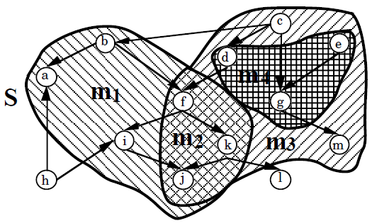
Operations on Modules
Inclusion
Union
Intersection
Empty module
Disjoint modules

Slide 8
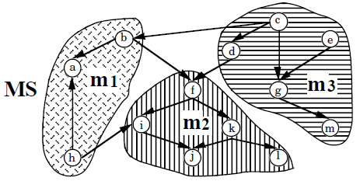
Modular Systems Representation
The 3-tuple MS = <E,R,M> represents a modular system if S = <E,R> is a system, and M is a collection of modules of S such that
∀e ∈ E (∃m ∈ M (m = <E_{m},R_{m}> and e ∈ E_{m}) ) and
∀ m₁,m₂ ∈ M (m₁ = <E_{m1},R_{m1}> and m₂ = <E_{m2},R_{m2}> and E_{m1} ∩ E_{m2} = ∅)
i.e, the set of elements E of MS is partitioned into the sets of elements of the modules.
We denote the union of all the R_{m}'s as IR. It is the set of intra-module relationships.
Since the modules are disjoint, the union of all OutputR(m)'s is equal to the union of all InputR(m)'s, which is equal to R-IR. It is the set of inter-module relationships.

Slide 9
Size
The size of a system S is a function Size(S) that is characterized by the following properties
Non-negativity
Null Value
Module Additivity
With reference to code measures, we have: LOC, #Statements, #Modules, #Procedures, Halstead's Length, #Occurrences of Operators, #Occurrences of Operands, #Unique Operators, #Unique Operands.
In each of the above cases, each counted entity is an element, and the relationship between elements is just the sequential relationship.

Slide 10
Length
The length of a system S is a function Length(S) characterized by the following properties:
Non-negativity
Null Value
Non-increasing Monotonicity for Connected Components: Let S be a system and m be a module of S such that m is represented by a connected component of the graph representing S. Adding relationships between elements of m does not increase the length of S.
Non-decreasing Monotonicity for Non-connected Components: Let S be a system and m₁ and m₂ be two modules of S such that m₁ and m₂ are represented by two separate connected components of the graph representing S. Adding relationships from elements of m₁ to elements of m₂ does not decrease the length of S.
Disjoint Modules: The length of a system S = <E,R> made of two disjoint modules m₁, m₂ is equal to the maximum of the lengths of m₁ and m₂

Slide 11
Complexity
The complexity of a system S is a function Complexity(S) that is characterized by the following properties:
Non-negativity
Null Value
Symmetry: The complexity of a system S = <E,R> does not depend on the convention chosen to represent the relationships between its elements.
Module Monotonicity: The complexity of a system S = <E,R> is no less than the sum of the complexities of any two of its modules with no relationships in common.
Disjoint Module Additivity: The complexity of a system S = <E,R> composed of two disjoint modules m₁, m₂ is equal to the sum of the complexities of the two modules.

Slide 12
Cohesion
The cohesion of a [module m = <E_{m},R_{m}> of a modular system MS | modular system MS] is a function [Cohesion(m)|Cohesion(MS)] characterized by the following properties:
Non-negativity and Normalization
Null Value
Monotonicity: Adding intra-module relationships does not decrease [module|modular system] cohesion.
Cohesive Modules: The cohesion of a [module|modular system] obtained by putting together two unrelated modules is not greater than the [maximum cohesion of the two original modules|the cohesion of the original modular system].

Slide 13
Coupling
The coupling of a [module m = <Em,Rm> of a modular system MS|modular system MS] is a function [Coupling(m)|Coupling(MS)] characterized by the following properties:
Non-negativity
Null Value
Monotonicity: Adding inter-module relationships does not decrease coupling.
Merging of Modules: The coupling of a [module|modular system] obtained by merging two modules is not greater than the [sum of the couplings of the two original modules|coupling of the original modular system], since the two modules may have common inter-module relationships.
Disjoint Module Additivity: The coupling of a [module|modular system] obtained by merging two unrelated modules is equal to the [sum of the couplings of the two original modules|coupling of the original modular system].

Slide 14
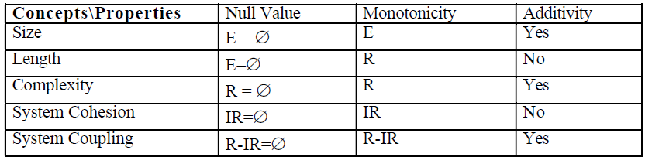
Comparison of Concept Properties
Coupling and cohesion are only defined in the context of modular systems, whereas size, length and complexity are defined for all systems.
The concepts appear to have the null value (second column) and monotonicity (third column) properties based on different sets.
When systems are made of disjoint modules, size, complexity and coupling are additive.

Slide 15


Slide 16
OO Software Metrics Problems [2]
Software metrics need to be constructed with a stronger degree of theoretical and mathematical rigor.
It is not surprising to find that software metrics developed with traditional methods in mind do not readily lend themselves to OO notions such as classes, inheritance, encapsulation and message passing.
It seems appropriate to develop a set, or suite of new metrics especially designed to measure unique aspects of the OO approach.

Slide 17
Measurement Theory Base
An object oriented design can be conceptualized as a relational system, which is defined as an ordered tuple consisting of a set of elements, a set of relations and a set of binary operations.
where
A is a set of object-elements
R₁ . . . R_{n}, are empirical relations on object-elements of A (e.g., bigger than, smaller than, etc.)
0₁ . . .O_{m} are binary operations on elements of A (e.g., combination)

Slide 18
Empirical Relations
A useful way to understand empirical relations on a set of object-elements is to consider the measurement of complexity.
For example, a designer intuitively understands that a class that has many methods is generally more complex than one that has few methods.
This intuitive idea is defined as a viewpoint.
An empirical relation is identical to a viewpoint, and the two terms are distinguished here only for the sake of consistency with the measurement theory literature.
A viewpoint must be of weak order.
Completeness: P is more complex than P’ or P’ is more complex than P
Transitivity: if P is more complex than P’ and P’ is more complex than P”, then P is more complex than P”

Slide 19

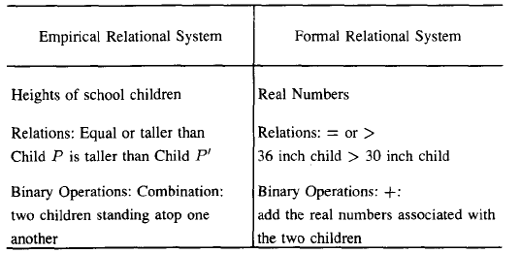
Formal Relational System
To be able to measure something about an object design, the empirical relational system as defined above needs to be transformed to a formal relational system.
C is a set of elements (e.g., real numbers)
S₁ . . . S_{n}, are formal relations on elements of C (e.g., >, <, =)
B₁ . . . B_{m}, are binary operations on elements of C (e.g., +. -, *)
The principle is that numerical representations produced by the transformation to formal systems help in better understanding the empirical system.

Slide 20
Ontological Definitions for Object Oriented Concepts
The world is viewed as composed of things, referred to as substantial individuals, and concepts.
A property is a feature that a substantial individual possesses.
All substantial individuals possess a finite set of properties.
Properties are recognized only through attributes. A known property must have at least one attribute representing it. Properties do not exist on their own, but are “attached” to individuals.
A substantial individual and its properties collectively constitute an object.
An object can be represented in the following manner:
X = (x, p (x)) where x is the substantial individual and p (x) is the finite collection of its properties.

Slide 21

Coupling
Two objects are coupled if and only if at least one of them acts upon the other, X is said to act upon Y if the history of Y is affected by X, where history is defined as the chronologically ordered states that a thing traverses in time.
Let X = (x , p (x)) and Y = (y, p(y)) be two objects.
where {M_{i}} is the set of methods and {I_{i}} is the set of instances variables of object i.
Since objects of the same class have the same properties, two classes are coupled when methods declared in one class use methods or instance variables of the other class.

Slide 22
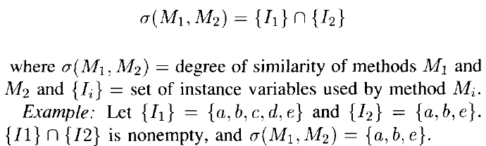
Cohesion
The degree of similarity of methods can be viewed as a major aspect of object class cohesiveness.
If an object class has different methods performing different operations on the same set of instance variables, the class is cohesive.

Slide 23

Thank You & See You Again

